Slide 1
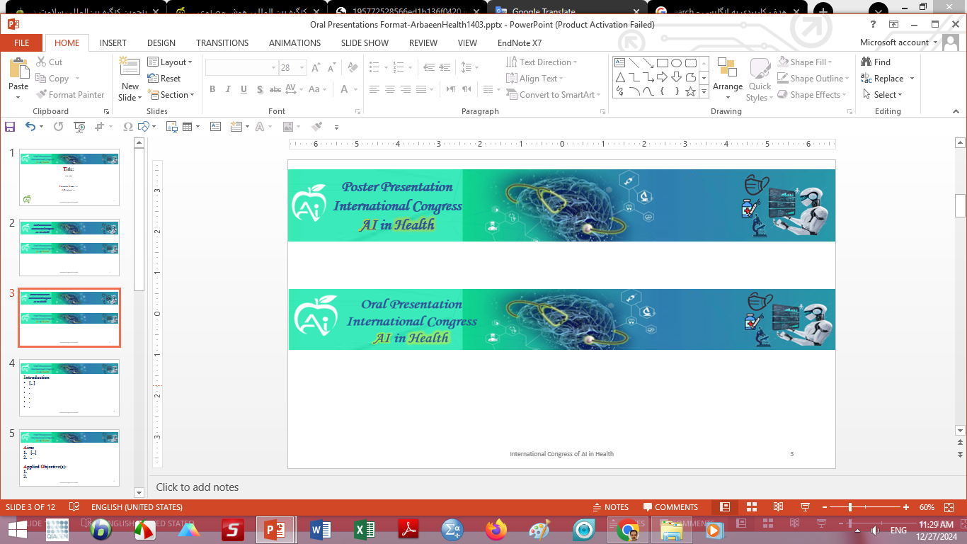

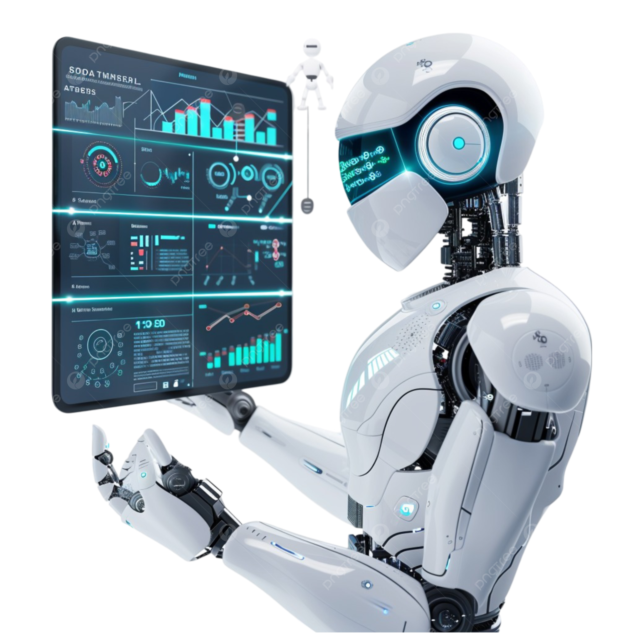


Title:
Authors: Sarev F., Tamanaei F (for example).
Logo of University or Institute
Affiliation: Immunology Department, Iran University of Medical Sciences, Tehran, Iran (for example).
Presenter Image
Present by: ….
Email: …
Results
Conclusions
Article code: …
Text
Text
Introduction
Methods
Text
Text
Acknowledgment
Presenter Image
Text
Aims
Presenter Image
References
Figure
Text
Text
Figure
Figure Caption

